Slide 1
Snowflake – Credits & Storage Usage
SNOWFLAKE Database
SNOWFLAKE is a system-defined, read-only shared database, provided by Snowflake which is imported into each account from a share named ACCOUNT_USAGE
The SNOWFLAKE database contains two schemas (also read-only). Each schema contains a set of views
ACCOUNT_USAGE
Views that display object metadata and usage metrics for your account.
These views mirror the corresponding views and table functions in the Snowflake Information Schema, but with the following differences:
Records for dropped objects included in each view. - records for all objects that have been dropped
Longer retention time for historical usage data - Certain account usage views provide historical usage metrics – 1 year, information schema – 7 days to 6 months
Data latency – Most Views the latency is 2 hours , remaining views, the latency varies between 45 minutes and 3 hours
READER_ACCOUNT_USAGE
Views that display object metadata and usage metrics for all the reader accounts that have been created for your account (as a Secure Data Sharing provider).

Slide 2
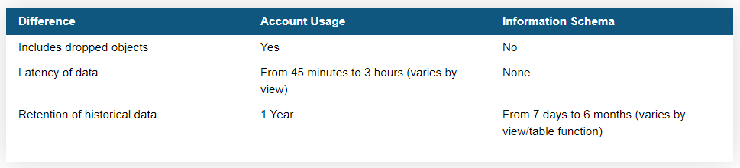
Snowflake – Credits & Storage Usage
Differences Between Account Usage and Information Schema
Enabling Account Usage for Other Roles
Imported Privileges
use role accountadmin;
grant imported privileges on database snowflake to role sysadmin;
grant imported privileges on database snowflake to role customrole1;
use role customrole1;
select * from snowflake.account_usage.databases;

Slide 3
Snowflake – Credits & Storage Usage
Information Schema
The Snowflake Information Schema (aka “Data Dictionary”) consists of a set of system-defined views and table functions that provide extensive metadata information about the objects created in your account
Each database created in your account automatically includes a built-in, read-only schema named INFORMATION_SCHEMA
Views for all the objects contained in the database, as well as views for account-level objects (i.e. non-database objects such as roles, warehouses, and databases)
Table functions for historical and usage data across your account
List of Table Functions

Slide 4
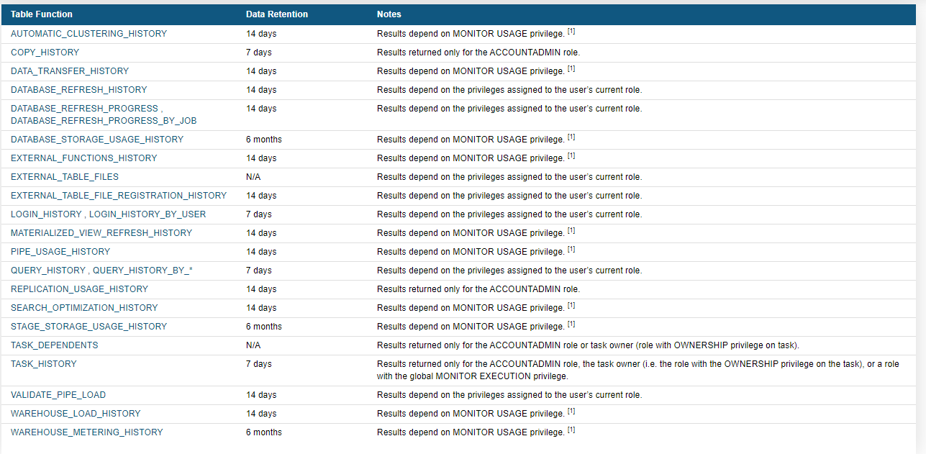
Snowflake – Credits & Storage Usage
List of Table Functions

Slide 5
Snowflake – Credits & Storage Usage
System Usage & Billing
Data Storage –
Calculated on the daily average amount of data (in bytes) stored in the system for:
Files staged for bulk data loading/unloading (can be stored compressed or uncompressed).
Database tables, including historical data for Time Travel (always compressed by Snowflake).
Fail-safe for database tables (always compressed by Snowflake).
Clones of database tables that reference data deleted in the table that owns the clones.
Compute Usage
Calculated based on the number of Snowflake credits consumed by virtual warehouses for executing queries, loading/unloading data, and performing other DML operations.
Cloud Services Usage
Charged only if the daily consumption of cloud services for the account exceeds 10% of the daily usage of the compute resources. The charge is calculated daily (in the UTC time zone). This ensures that the 10% adjustment is accurately applied each day, at the credit price for that day.

Slide 6
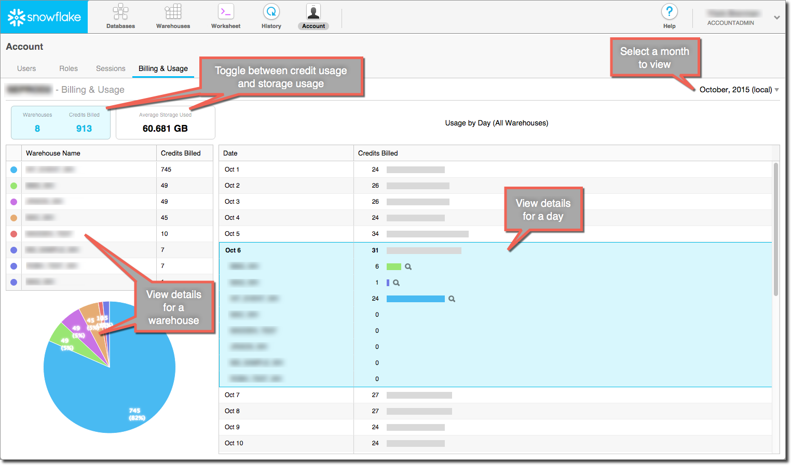
Snowflake – Credit & Storage Usage
Web UI

Slide 7
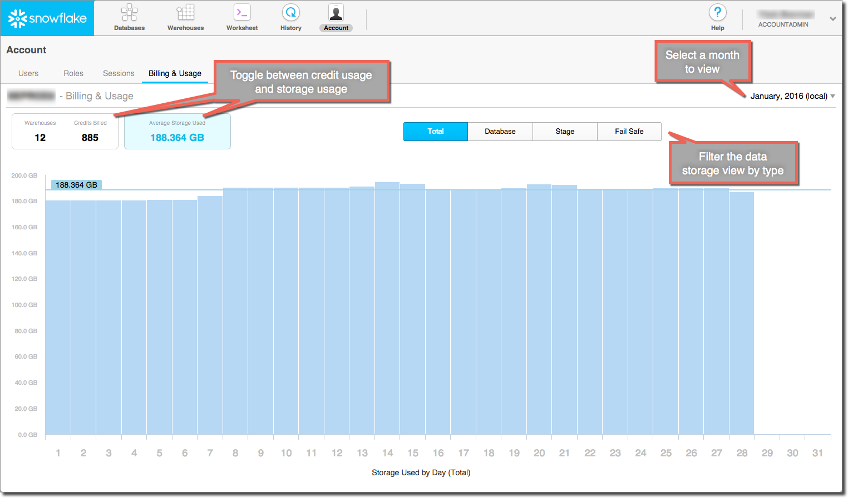
Snowflake – Credit & Storage Usage
Data Storage Usage

Slide 8
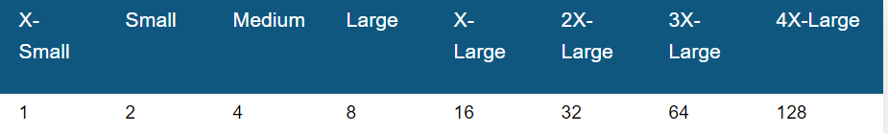
Snowflake – Credits & Storage Usage
Snowflake Credits
All costs for compute resources in Snowflake are based on credit
Credits are Billed per second
When a warehouse is increased in size, credits are billed only for the additional servers that are provisioned. For example, changing from Small (2) to Medium (4) results in billing charges for 1 minute’s worth of 2 credits
Warehouse started or resized – 1 minute Billing after this its 1 sec billing
Warehouse increased – Billed for Increased Server Size
Eg : Small(2) → Medium(4) – Billing Charges 1 Min – 2 Credits
Viewing Warehouse Credit Usage for Your Account
Web UI – Credit Usage
Account → Billing Usage
Function → WAREHOUSE_METERING_HISTORY

Slide 9
Snowflake – Credits & Storage Usage
Viewing Warehouse Credit Usage for Your Account
Returns results only for the ACCOUNTADMIN role or any role that has been explicitly granted the MONITOR USAGE global privilege.
When calling an Information Schema table function, the session must have an INFORMATION_SCHEMA schema in use or the function name must be fully-qualified.
WAREHOUSE_METERING_HISTORY
This function returns credit usage within the last 6 months.
Function : WAREHOUSE_METERING_HISTORY table function (in the Information Schema) / View (in Account Usage).
This view enables you to see how much of an adjustment you receive each day (which offsets your cloud services usage up to 10% of compute credits) and, therefore, the net credits that you will be billed for.
Credits_Used + Credits_Adjustment_Cloud_Services = Credits_Billed. (The adjustment is a negative number.)
Metering_Daily_History view
Total credit usage for compute and cloud services: Credits_Used, Credits_Used_Cloud_Services, and Credits_Used_Compute
Credits_Used = Credits_Used_Cloud_Services + Credits_Used_Compute
Arguments
DATE_RANGE_START => constant_expr
DATE_RANGE_END => constant_expr
WAREHOUSE_NAME => 'string’
Examples
select *
from table(information_schema.warehouse_metering_history(dateadd('days',-10,current_date())));
select *
from table(information_schema.warehouse_metering_history('2017-10-23', '2017-10-23', 'testingwh'));

Slide 10
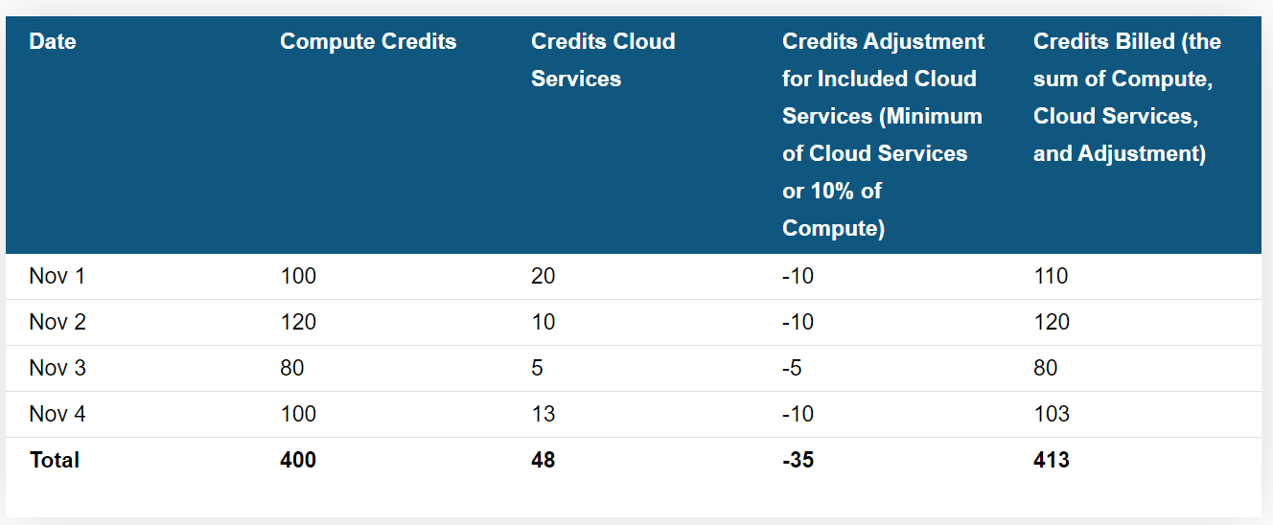
Snowflake – Credit & Storage Usage
Cloud Services Credit Usage
Similar to virtual warehouse usage, Snowflake credits are used to pay for the usage of the cloud services that exceeds 10% of the daily usage of the compute resources
The 10% adjustment for cloud services is calculated daily (in the UTC time zone) by multiplying daily compute by 10%.
The adjustment on the monthly usage statement is equal to the sum of these daily calculations.
If cloud services consumption is less than 10% of compute credits on a given day, then the adjustment for that day is equal to the cloud services the customer used
.

Slide 11
Snowflake – Credits & Storage Usage
Viewing Cloud Services Credit Usage
ACCOUNT_USAGE:
Query the METERING_HISTORY to view hourly usage for an account.
Query the METERING_DAILY_HISTORY to view daily usage for an account.
Query the WAREHOUSE_METERING_HISTORY to view usage for a warehouse.
Query the QUERY_HISTORY to view usage for a job.
INFORMATION_SCHEMA:
Query the QUERY_HISTORY table function.
Patterns Affecting Cloud Services
Copy commands with poor selectivity
High frequency DDL operations or cloning
High frequency, simple queries
High frequency Information_Schema queries
Result scan
High frequency Show commands (most often seen with data applications or third-party tools)
Single row inserts and fragmented schemas (most often seen with data applications)
Complex SQL queries

Slide 12
Snowflake – Credits & Storage Usage
Viewing Data Usage for Your Account
Table functions (in the Information Schema):
DATABASE_STORAGE_USAGE_HISTORY
STAGE_STORAGE_USAGE_HISTORY
Views (in Account Usage):
DATABASE_STORAGE_USAGE_HISTORY View
STAGE_STORAGE_USAGE_HISTORY View
Viewing Data Usage for a Table
Table functions (in the Information Schema):
DATABASE_STORAGE_USAGE_HISTORY
STAGE_STORAGE_USAGE_HISTORY
Views (in Account Usage):
DATABASE_STORAGE_USAGE_HISTORY View
STAGE_STORAGE_USAGE_HISTORY View
Viewing Data Usage for a Table
Execute a SHOW TABLES command.
TABLE_STORAGE_METRICS view (in the Information Schema).
TABLE_STORAGE_METRICS View view (in Account Usage).

Slide 13
Snowflake – Credit & Storage Usage
Data Transfer Billing
Cloud providers apply data egress charges in either of the following use cases:
Data is transferred from one region to another within the same cloud platform.
Data is transferred out of the cloud platform.
To recover these expenses, Snowflake charges a per-byte fee when users transfer data from your Snowflake account (hosted on AWS, Google Cloud Platform, or Microsoft Azure) into cloud storage in another region on the same cloud platform, or into cloud storage in another cloud platform.
Unloading Data from Snowflake
Database Replication
Data Transfer History
The COPY INTO <location> command can unload data from a table (or query) into files in an external stage. This activity is available to view for 14 days
DATA_TRANSFER_HISTORY table function (in the Information Schema).
DATA_TRANSFER_HISTORY View view (in Account Usage).

Slide 14
Snowflake – Credit & Storage Usage
Resource Monitors
Credit Quota
Credit quota specifies the number of Snowflake credits allocated to the monitor for the specified frequency interval.
Resets back to 0 when the frequency is done
Monitor Level
This property specifies whether the resource monitor is used to monitor the credit usage for your entire Account (i.e. all warehouses in the account) or a specific set of individual warehouses.
Schedule
Default Schedule
Starts monitoring credit usage immediately
used credits reset back to 0 at the beginning of each calendar month
Frequency
Daily
Weekly
Monthly
Yearly
Never (used credits never reset; assigned warehouses continue using credits until the credit quota is reached)

Slide 15
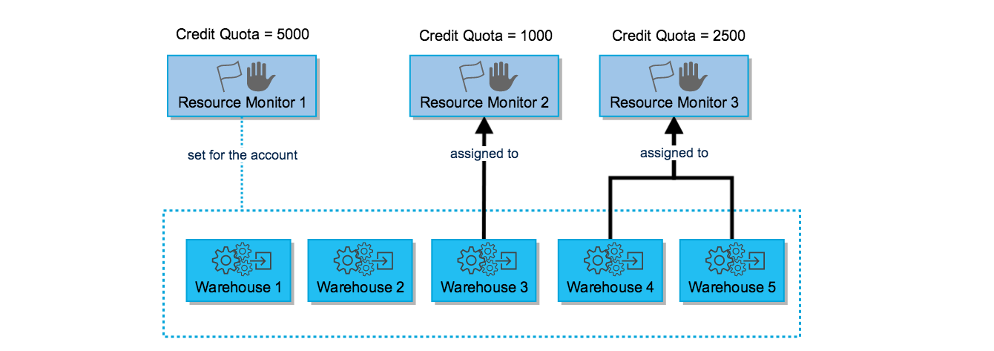
Snowflake – Credit & Storage Usage
Actions
Notify & Suspend
Notify & Suspend Immediately
Notify
Resource Monitor Assignment

Slide 16
Snowflake – Credit & Storage Usage
Resource Monitors – Creation
CREATE RESOURCE MONITOR
ALTER RESOURCE MONITOR
SHOW RESOURCE MONITORS
DROP RESOURCE MONITOR
CREATE WAREHOUSE or ALTER WAREHOUSE
SHOW WAREHOUSES
Web UI
Make sure you are using the ACCOUNTADMIN role.
Click on Account -> Resource Monitors -> Create Resource Monitor.
Enter a name and quota.
Specify whether the resource monitor will be used for monitoring your account or individual warehouses.
Enter a threshold for at least one of the suspend actions. You can also specify up to five notify actions that simply send alerts without suspending any warehouses.
use role accountadmin;
create or replace resource monitor limit1 with credit_quota=1000
triggers on 50 percent do notify
on 75 percent do notify
on 100 percent do suspend
on 110 percent do suspend_immediate;
alter warehouse wh1 set resource_monitor = limit1;

